Slide 1
NeoNet Enterprise: Babel
Ujjwal Sharma, Pratham Parakh and Vivek Sondagar

Slide 2


FUNCTIONALITIES
User management
Property checking
Real Time Conversations
Summary
Recommender
Sales

Slide 3
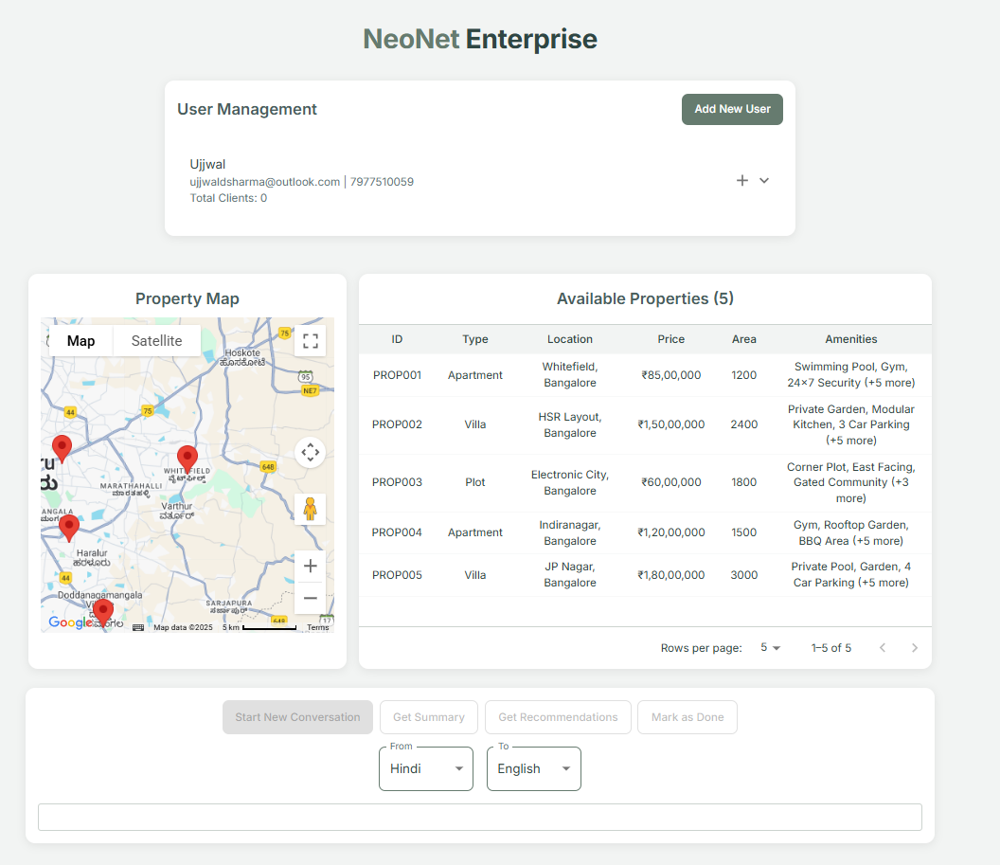
Our approach to the site is one guided by necessity–- stemming from multilingualism in India, and stretching to a more generalized helper

Slide 4
Add user
Add client
Property Map
Available Properties
Language
Start new conversation
Client status
Summary
Recommendation
Tech Stack
Front End
Back End
Flask
Gemini
Google Cloud Services
React
Material UI
Google Maps JS API
Pandas, numpy and scipy
Sounddevice
GTTS

Slide 5
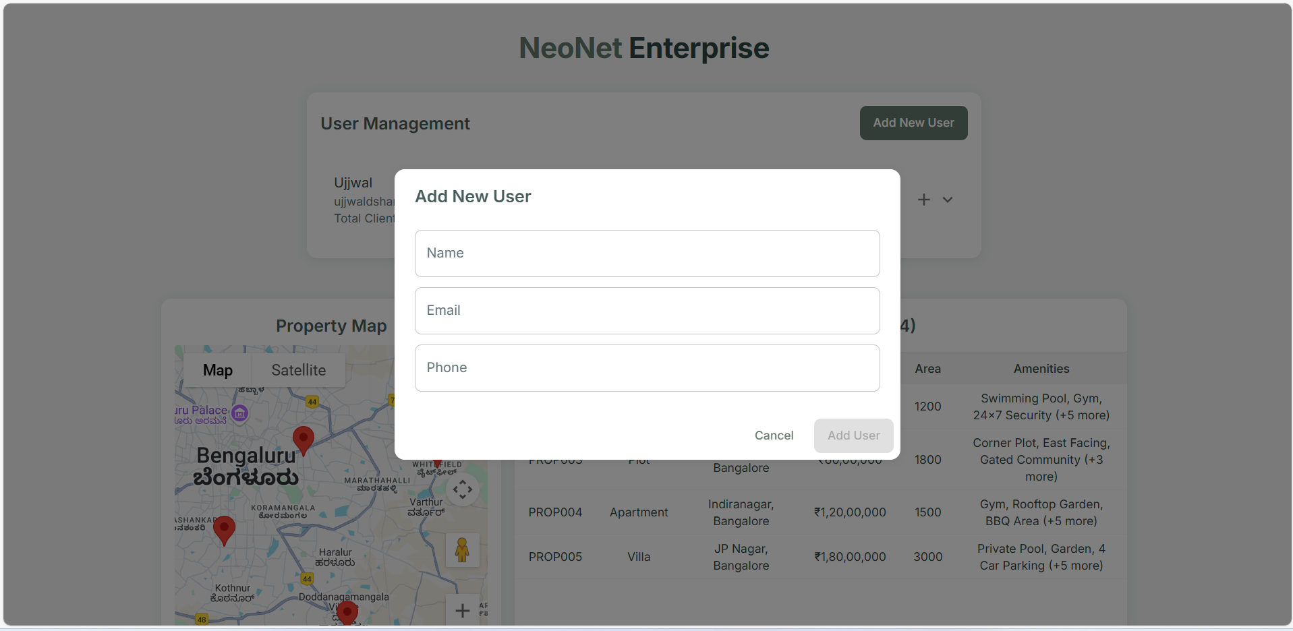
USER MANAGEMENT
Profiles for agents

Slide 6
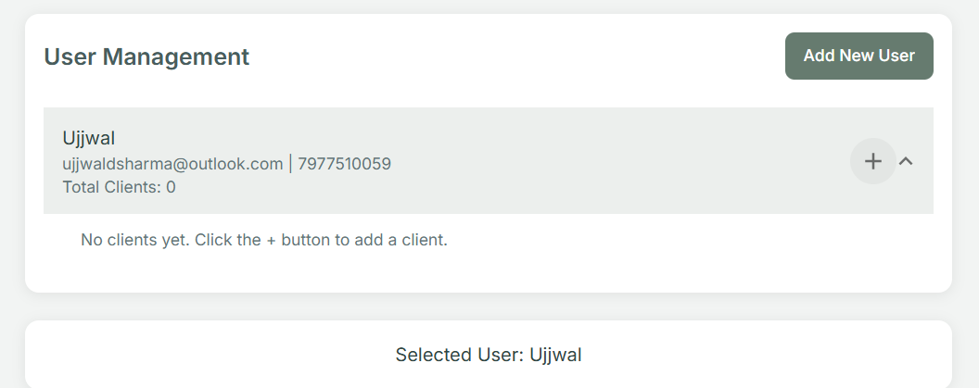
USER MANAGEMENT
Profiles for agents

Slide 7
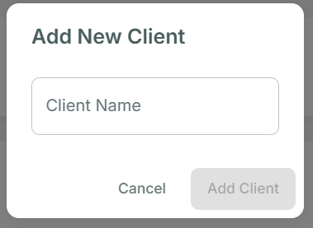
USER MANAGEMENT
Profiles for agents

Slide 8
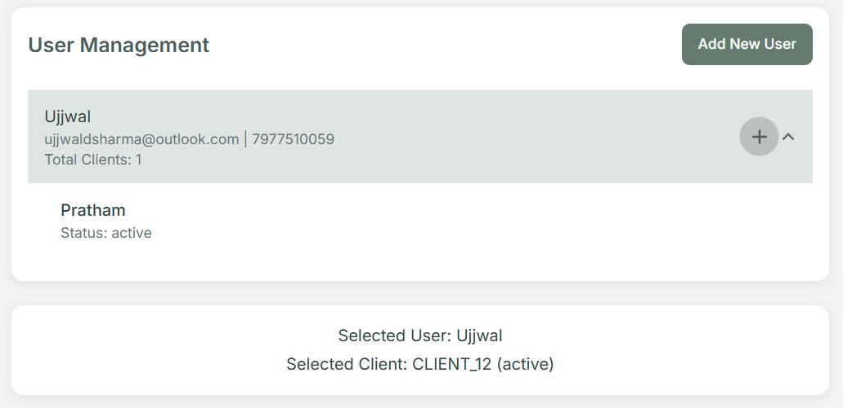
USER MANAGEMENT
Profiles for agents

Slide 9
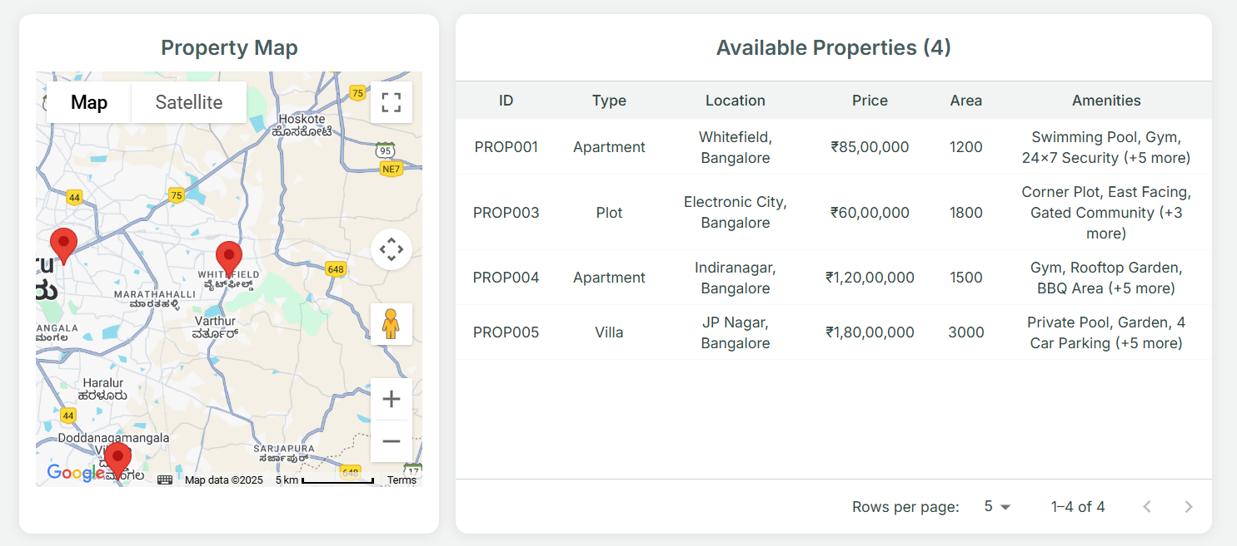
Viewing property sales options

Slide 10
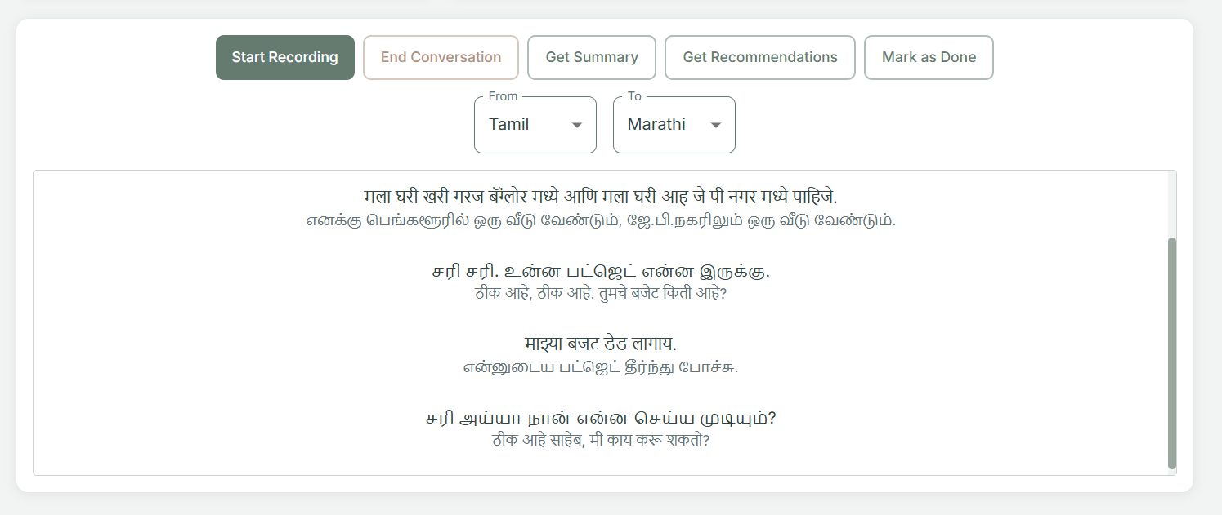
Translation

Slide 11
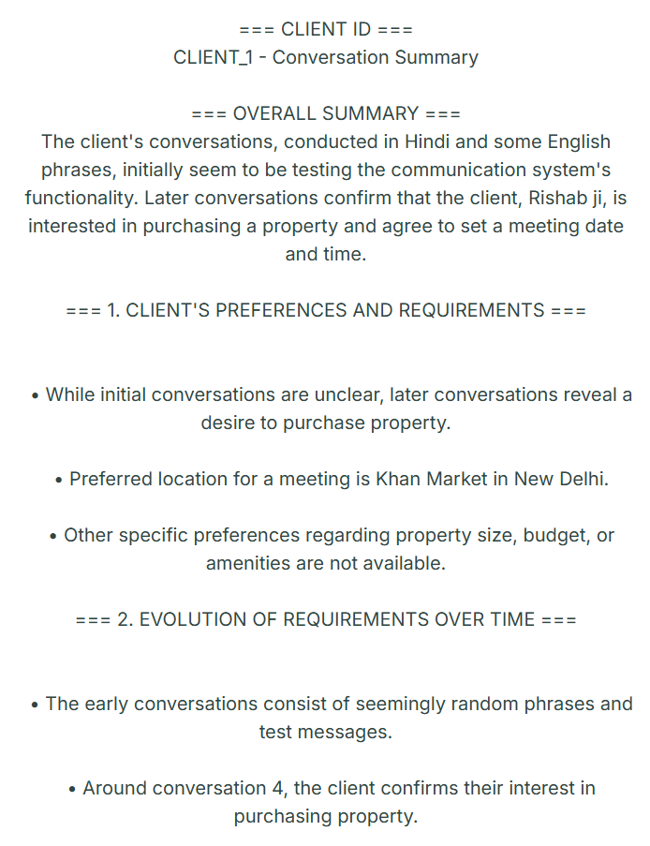
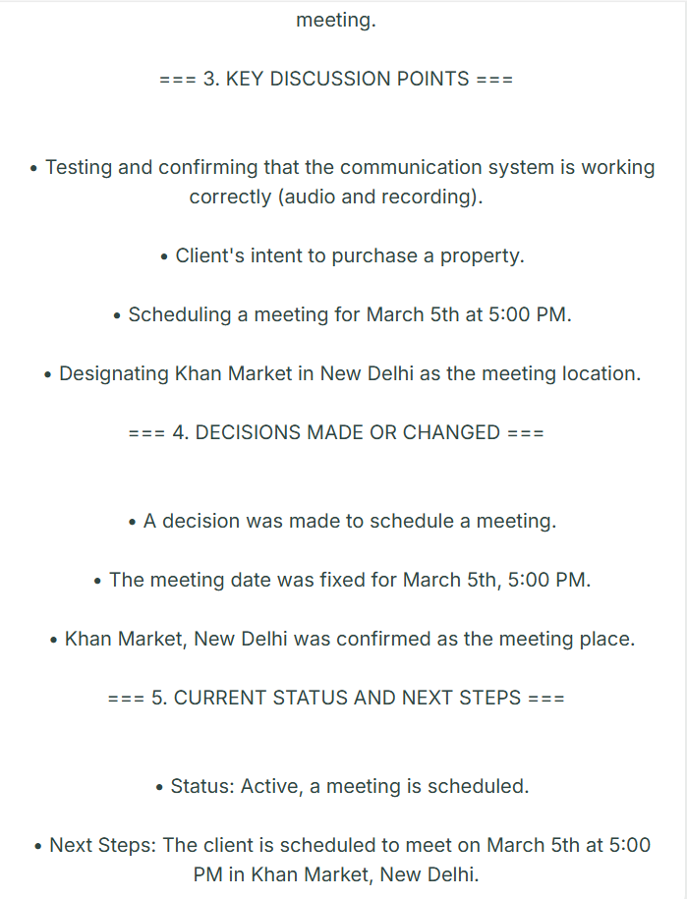
Summary

Slide 12
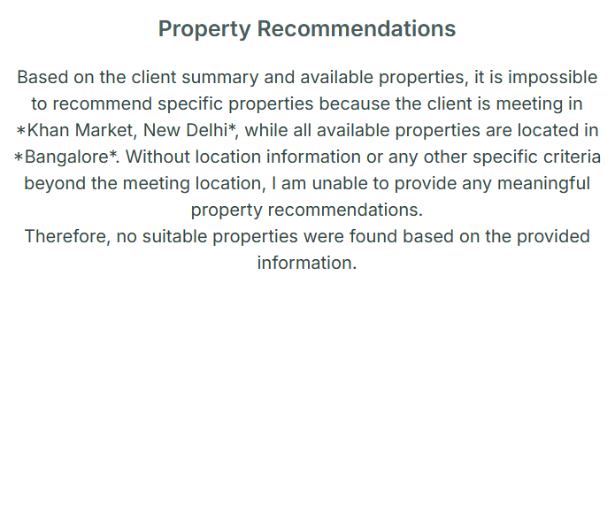
Recommendation engine

Slide 13
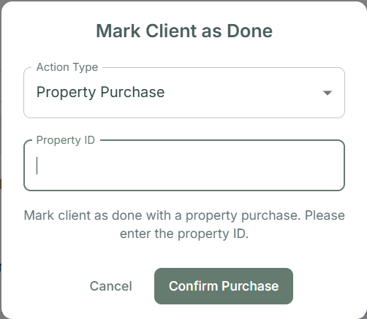
Closing clients

Slide 14
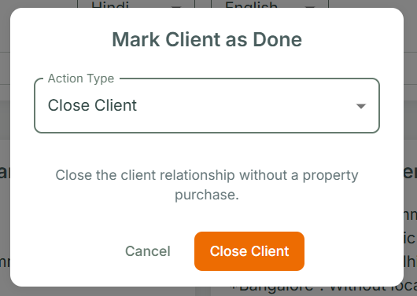
Closing clients

Slide 15
THANK YOU
UJJWAL SHARMA, PRATHAM PARAKH AND VIVEK SONDAGAR
https://github.com/uscool/babel-neonet/

